Slide 1
Welcome to Recharge Our Community’s Economy (ROCE): A Community Action Workshop Series
Chester, CA Lake Almanor Basin

Slide 2
Welcome & Introductions
Notes:
V

Slide 3

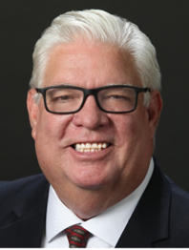
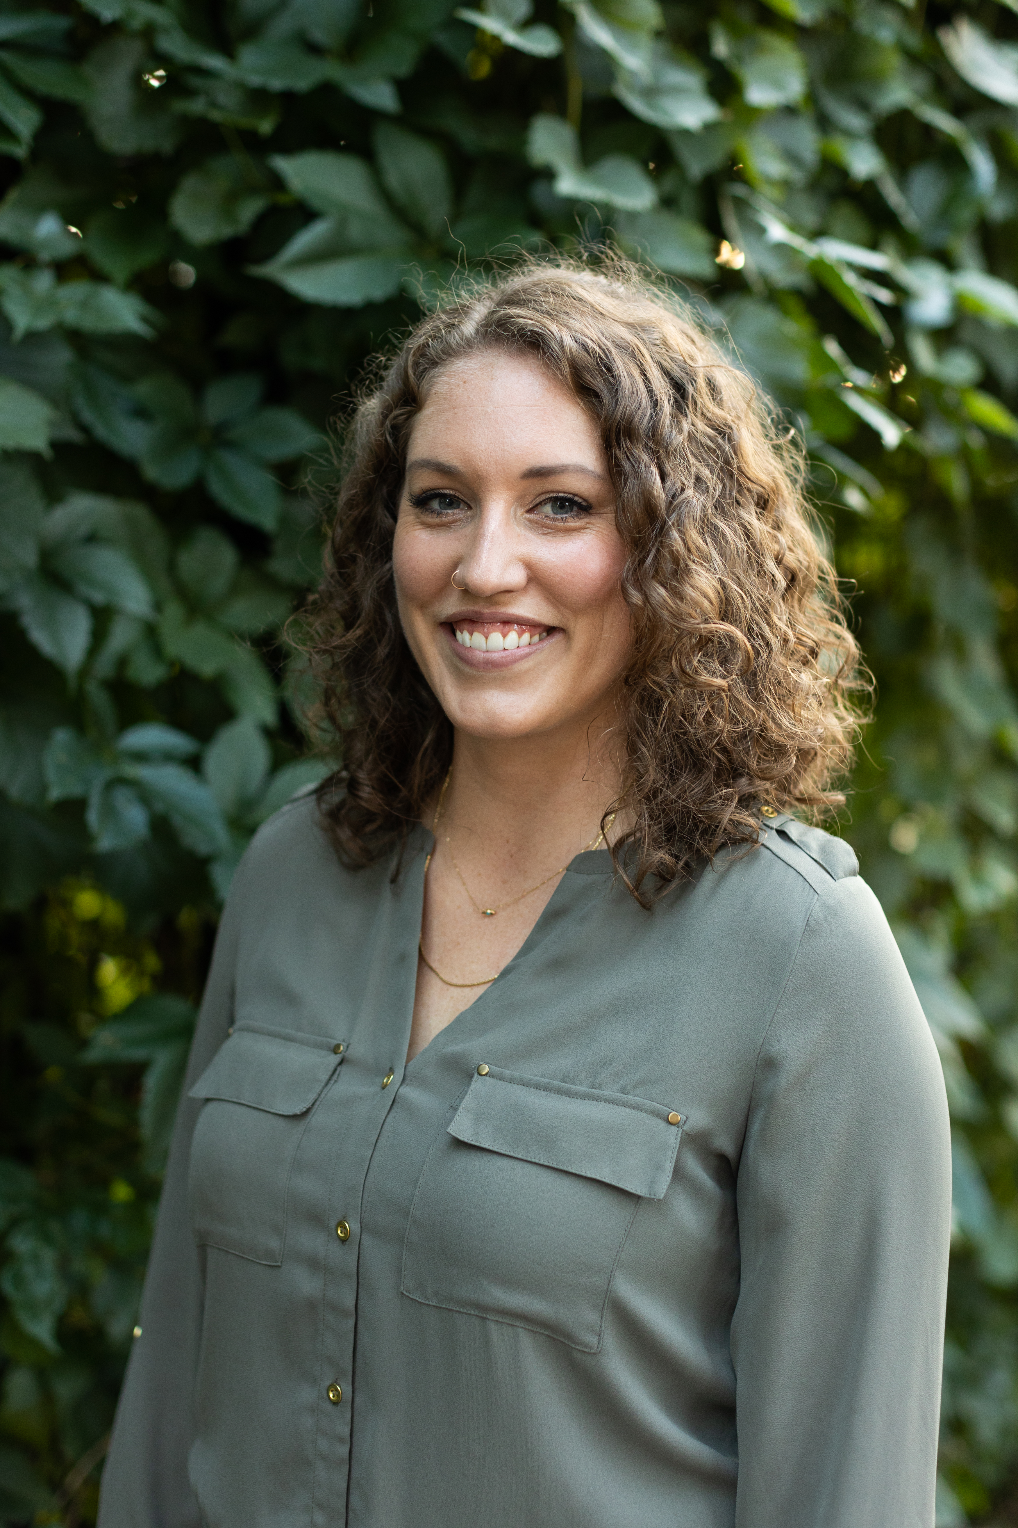
Your RCAC / ERC Facilitators
Verna "V" Al-ag
Community Economic Development Consultant
RCAC | (831) 887-8362
Vernalou.al-ag@rcac.org
Dan Dever
Community Economic Development Consultant
RCAC | (602) 818-9409
dan.dever@rcac.org
Carissa Patrone Maikuri
Economic Recovery Corps Fellow
ERC & RCAC | (734) 365-3801
Carissa.PatorneMaikuri@rcac.org
© 2019, Rural Community Assistance Corporation. All rights reserved.
Notes:
Facilitators self introduction and offer a brief small business and or small business coaching background.

Slide 4
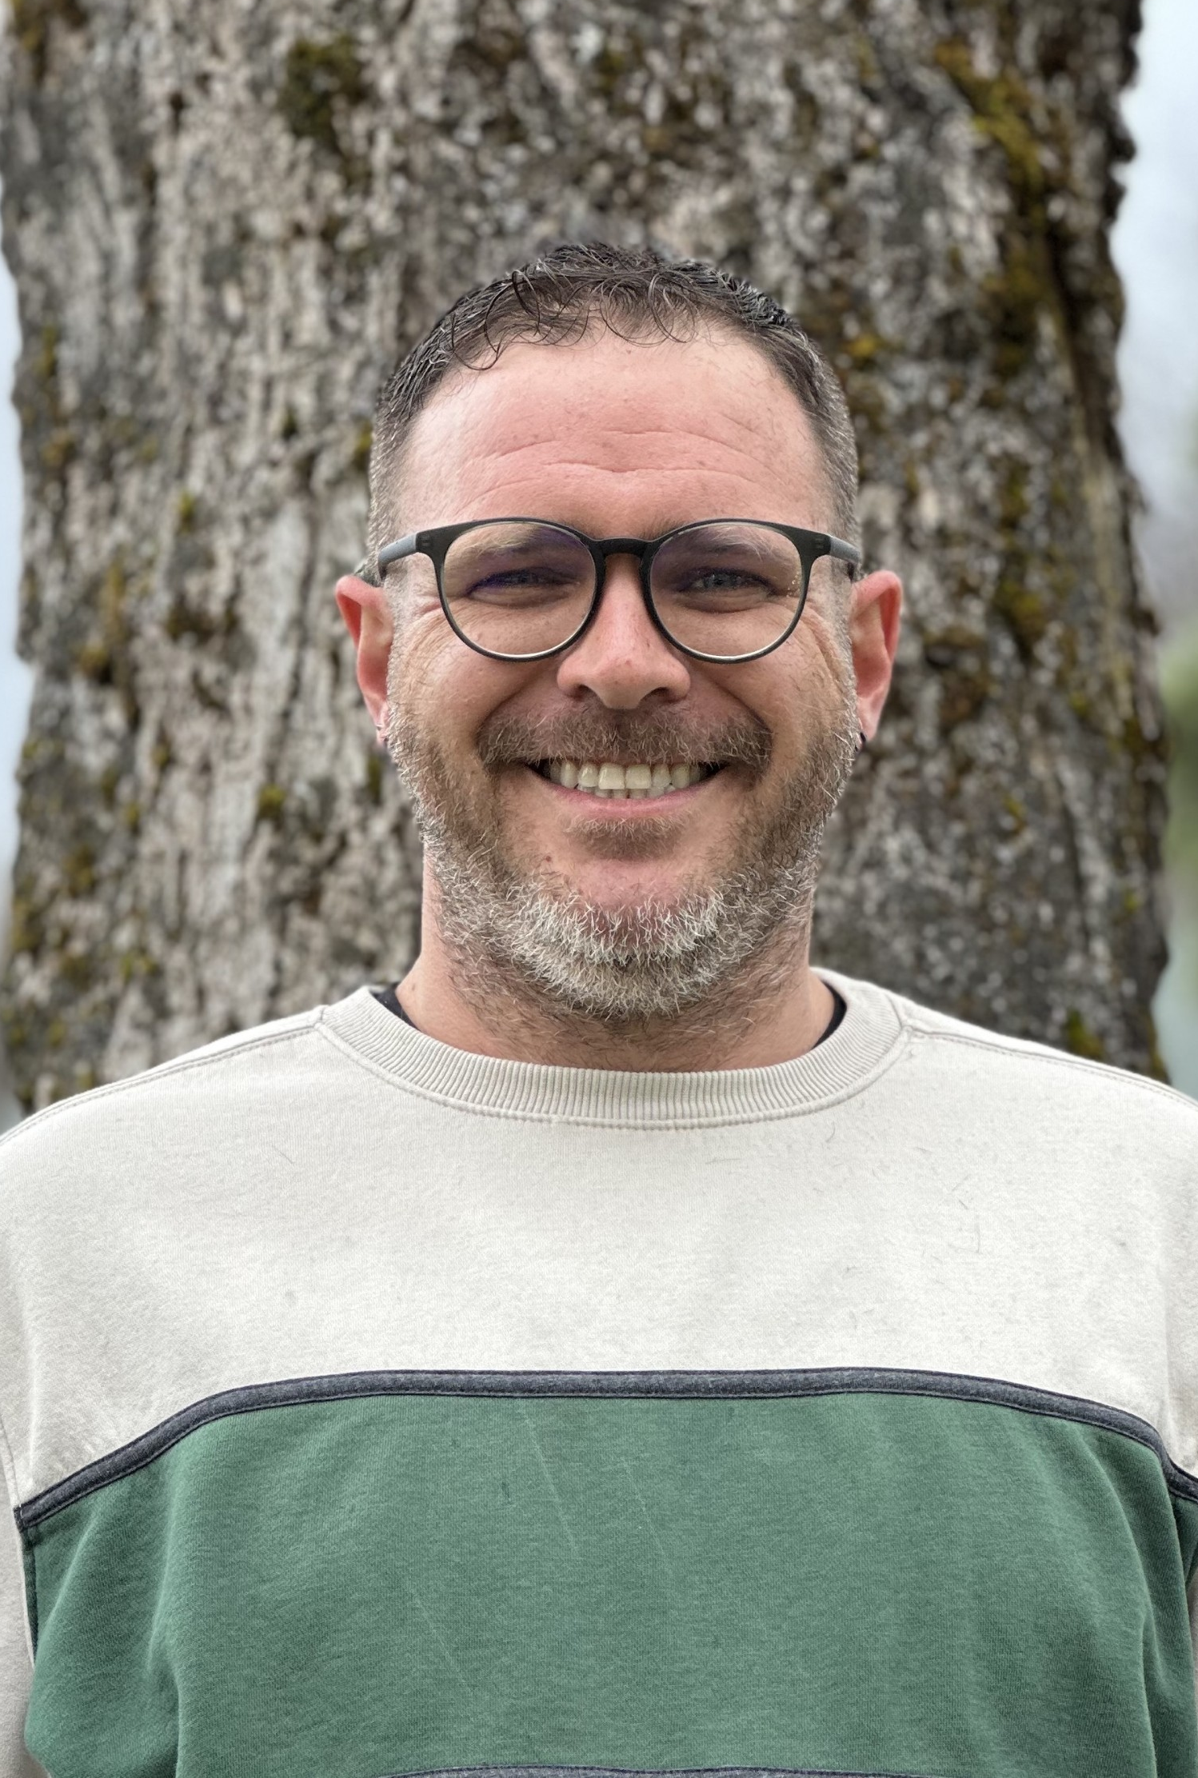
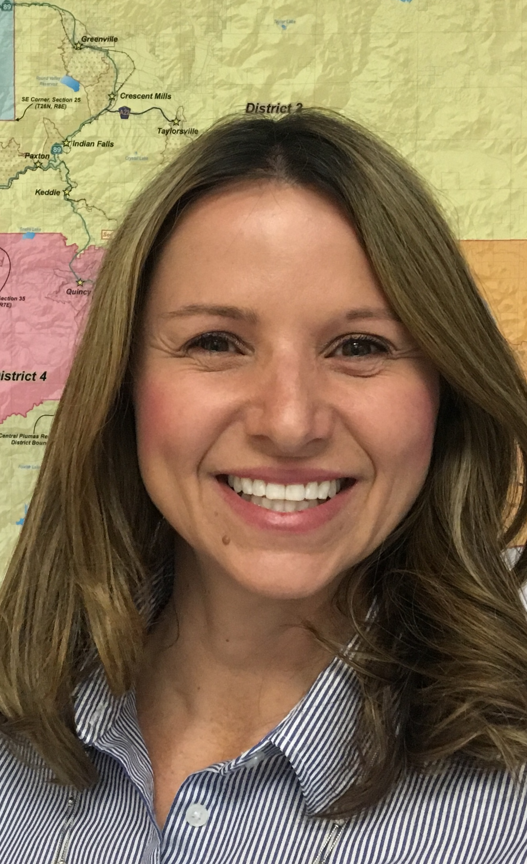
Your Plumas County Facilitators
Zachary Gately
Grant Manager
Plumas County
(530) 283-6414
ZacharyGately@countyofplumas.com
Tracey Ferguson
Planning Director
Plumas County
(530) 283-6214
TraceyFerguson@countyofplumas.com
© 2019, Rural Community Assistance Corporation. All rights reserved.
Notes:
Facilitators self introduction and offer a brief small business and or small business coaching background.

Slide 5

Funder Acknowledgment
RCAC and the Building Rural Economies’ (BRE) work with the County of Plumas in Chester are possible thanks to support from the U.S. Department of Housing and Urban Development’s Rural Capacity Building Grant Program.

Slide 6


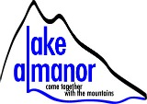

Community Partners & Sponsors
Notes:
Dan
Acknowledge ROCE Recruitment Committee, have sponsors introduce themselves as well

Slide 7
Work with Plumas County in Chester
Timeline: June 2025 - June 2027 and beyond
Focus of Work:
Identify priority economic development projects/programs in and of importance to Chester / Lake Almanor Basin.
Find champions and partners needed for implementation.
Create action plans and secure funding needed to execute.
Goal: Create viable economic development endeavors that produce community wealth!
Notes:
Zachary & Tracey
Mention two-project grant (RERC)

Slide 8
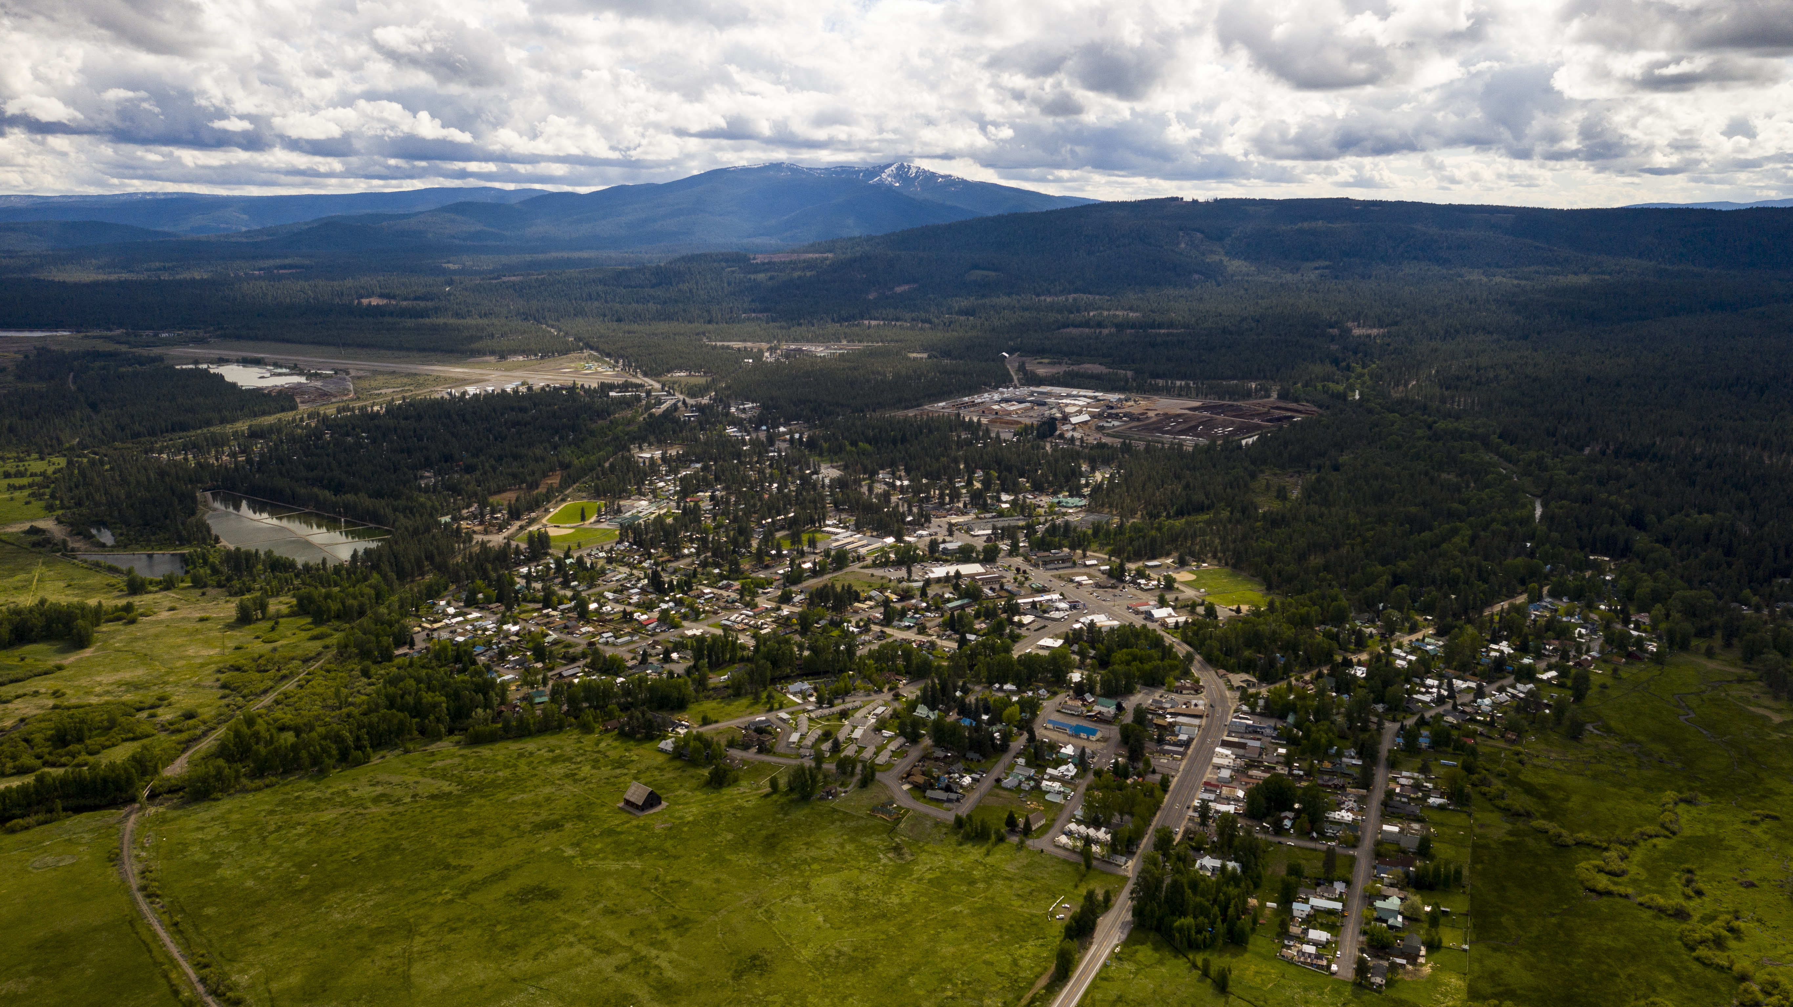
Purpose of ROCE
Identify and foster community-driven economic development opportunities through interactive elements that help participants:
Recognize assets/resources that already exist in the community.
Strategize ways those assets and resources can be used to create sustainable economic opportunities.
Develop and maintain ownership of the new opportunities identified.
Engage partners needed to make new opportunities a reality.
Notes:
Zachary

Slide 9
Workshop Schedule 2025
Workshop 1: Wednesday, September 3
Workshop 2: Wednesday, October 1
Workshop 3: Wednesday, October 29
Workshop 4: Wednesday, November 19
Reception after Workshop 4
9:00am - 2:00pm
Notes:
Zachary

Slide 10

Creating a Trusting & Open Environment
Be open to this experience and each other.
Be authentic - speak your truth without blame or judgement.
Listen attentively and minimize distractions.
Take space and make space.
Respect other’s thoughts even if they differ from your own.
Notice moments of discomfort and stay curious.
Assume positive intent.
Be open to all communication styles.
Be “All In” - you get out what you put into this process.
Notes:
Dan
These are our expectations and ground rules. Let’s take a moment to walk thru them together
Ask Questions
Take notes
Please attend all sessions
Please reach out to us
Please do your best with assignments
Minimize distractions
Others?

Slide 11

Parking Lot
Notes:
Dan

Slide 12
Today's Agenda
Workshop logistics & introductions
Project identification recap
Value chain group formation
Problem/solution
Value chain mapping
Action planning
Next steps

Slide 13
Participant Introductions
Your name and connection to Chester
One thing you’re proud of that’s happening in the community right now — big or small.

Slide 14
Project Criteria
Are there projects identified in previous planning documents?
Is there ownership identified?
Can all or part of the project be implemented within the next 2.5 years?
Will this support new or current businesses?
Does this utilize existing assets in the community?
Notes:
Dan

Slide 15
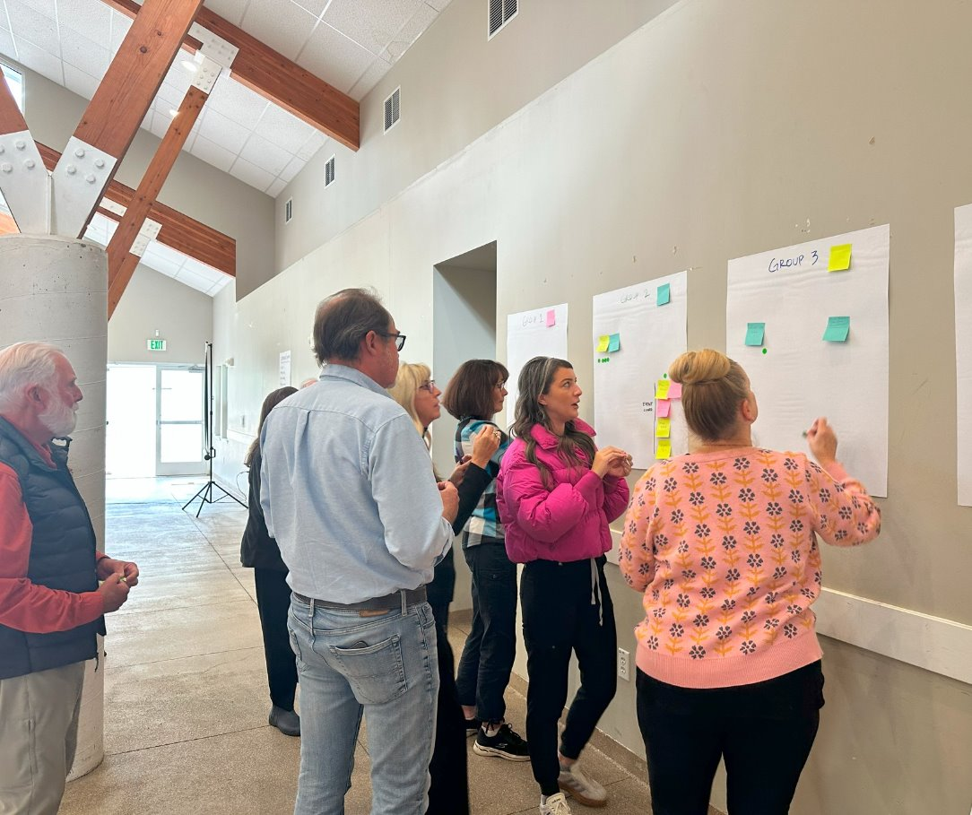
Top Three Proposed Projects/Initiatives (Value Chains)
Event(s) coordinator
Town square/plaza
Car rental/ride share
© 2019, Rural Community Assistance Corporation. All rights reserved.
Notes:
Share with participants that one of the most common challenges to getting a VC to something more than a plan is for the right partners to be brought together and for there to be significant interest and value for everyone.
There has to be ownership for the VC and or the multiple businesses that exist within the Vchains.
Ownership can take many forms? (read through slide)
It has to be clear (ownership has to be identified) in VC; who are the business owners and who is taking responsibility to move the VC forward.
Community Coordinators play a significant role in assisting VC to move forward but they do not own the VC, they assist in facilitating the pieces of the VC and take on when RCAC is no longer providing Training, Facilitation or Technical Assistance.
Ask the participants who has ownership of their VC’s?
Record responses; brainstorm with the full group if some of the VCs have not determined who would take ownership and responsibility? Help think through this with the groups.

Slide 16

Pre-Work – Community Feedback

Slide 17

Project/Initiative Value Chain Group Activity
Write your name next to the value chain
you want to work on

Slide 18

Break

Slide 19
Problem & Solution
Notes:
V

Slide 20
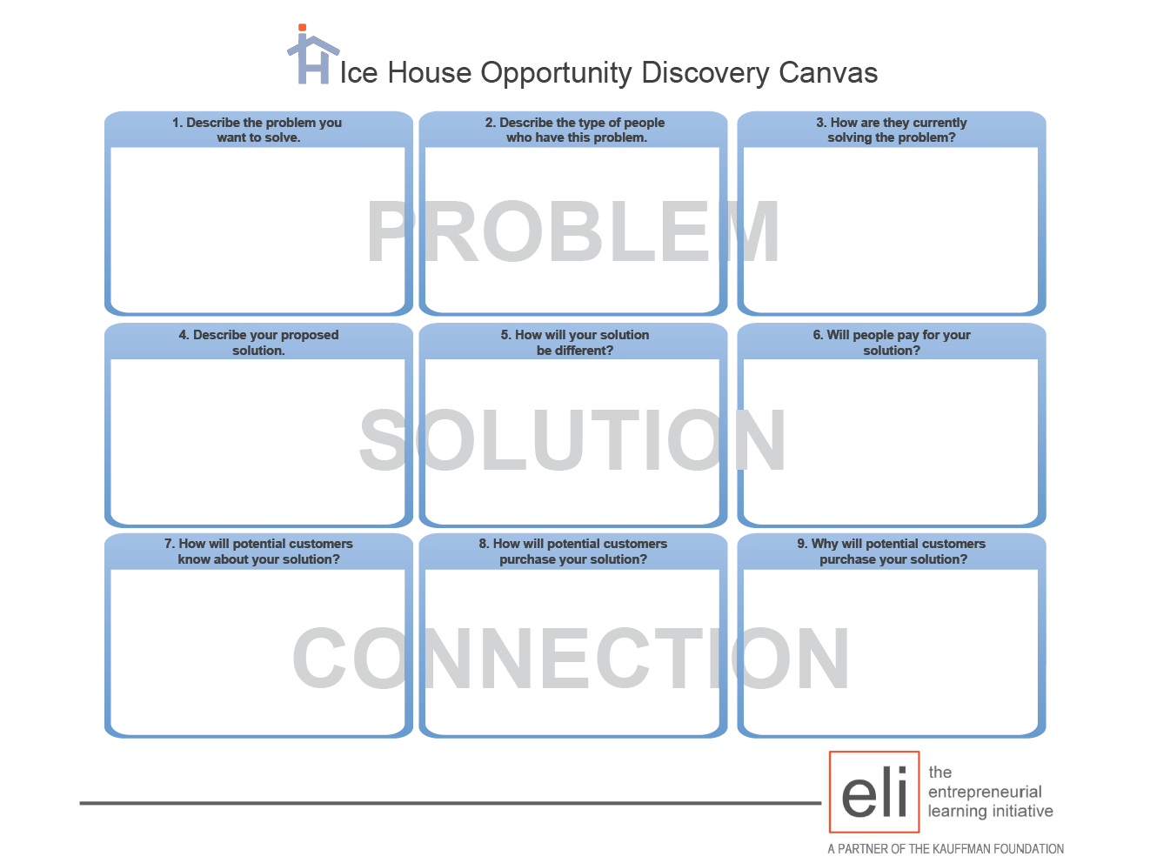
Notes:
Talk through each box in the Discovery Canvas, emphasize the PROBLEM - SOLUTION - CONNECTION
Pause to confirm understanding, this is often a new way of thinking for participants.

Slide 21
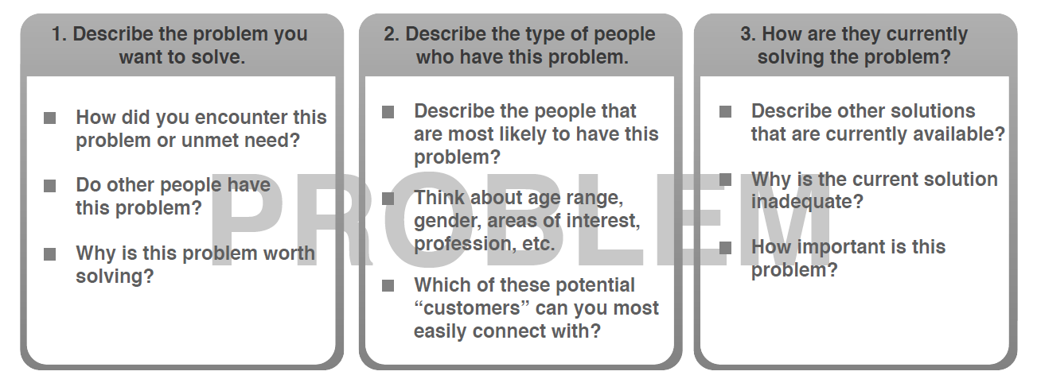
The Problem
© 2019, Rural Community Assistance Corporation. All rights reserved.
Notes:
Amity:
As Nick mentioned, most Value Chains start with a “solution” already in mind. This can make it difficult to think of the product, service or project being developed as the solution to a need or problem. Assumptions about a potential customer's or a community's underlying problem are often made subconsciously without even realizing it. It's important to take a step back, to double check that those assumptions are true, and to make sure the product, service or project is the solution to an actual problem; rather than an assumed problem.
Often when we begin the discussion of reframing a value chain as the solution to a problem, we'll hear something like "I want to start a coffee shop. The problem is we don't have one and we need one." But, just because something doesn't already exist, that doesn't mean bringing it to the community solves a problem. Lets take a step back and think about the actual problem a coffee shop solves. Coffee shops typically have trained baristas that create high-quality espresso-based drinks using sophisticated commercial equipment with a variety of options for flavors and toppings. The underlying problem a coffee shop actually solves is that people want these types of drinks (and are willing to pay for them) because they don't have the equipment, knowledge or ingredients to make them at home. Perhaps the reason a coffee shop doesn't already exist is that the people who live in the community are just as happy drinking black coffee that they can make themselves at home. Moving forward without confirming that a coffee shop solves a problem for its potential customers could spell disaster for the business if people in the community don't have the problem it was assumed they did.
Completing the questions in the Problem section of the Ice House Discovery Canvas can help identify the underlying problem a product, service or project solves as well as any subconscious assumptions. Lets look at the Problem section of the canvas closer in the context of the Community Scenario from Module #1.
Box One: Describe the problem you want to solve. You might answer this question by saying something like, the grocery store on the Reservation has only a limited selection of fresh fruits and vegetables that are expensive and not locally grown. While this might seem like the problem to be solved, we need to dig a little deeper. If most people in the community have large gardens and don't buy their produce from a store, having more fresh fruits and vegetables available at the local grocery store doesn't actually solve a problem. A more accurate way to describe the underlying problem might be that community members, businesses and schools on the Reservation want affordable, locally-grown, fresh fruits and vegetables but don't have the space, time, knowledge or desire to grow their own. Be careful tough. Does this statement include any subconscious assumptions? Until the Cooperative Farmers actually talk to potential customers this is just an assumption. Maybe community members are just as happy to eat the inexpensive canned fruits and vegetables available at the local grocery store. Or maybe the local restaurant and schools don't care whether the produce they use is locally-grown as long as its cheap.
The last question in Box One asks Why is this problem worth solving? Potential answers to this question could reference the fact that community members want and deserve access to affordable locally-grown fresh produce. Other potential answers to this question could focus on how incorporating more fresh fruits and vegetables into community member's diets can improve chronic health issues or how growing these types of products locally can help address food sovereignty issues.
Box Two: Describe the type of people who have this problem. You might say, that's easy - everyone on the Reservation. This may seem like a simple answer, but again its important to dig a little deeper. Does the statement include assumptions. Its more than likely there are community members who want affordable, locally-grown, fresh fruits and vegetables. However, its also likely there is a segment of the population that doesn't really care. A more accurate way to describe the people who have this problem might be individuals who live on the reservation that believe it is important to eat locally-grown produce. Other potential descriptions could focus on community members with limited access to transportation who have difficulty driving to the Border Town or people with medical conditions who need high quality food and nutrients. In all reality there are very few products or services whose customers include everyone. The questions in box two are designed to help determine who should be considered a potential customer, whether they have any common traits (for example age, gender or location), and whether there are enough of them to make the Cooperative Farm a sustainable business.
Box Three: How are they currently solving the problem? Potential customers (remember these are only the people on the Reservation who care about eating locally-grown fresh produce for one reason or another) either drive to the Border Town, purchase from the grocery store's limited and expensive selection or eat canned fruits an vegetables even though they would rather have fresh. The questions in box three are designed to help determine the sources of competition for the Cooperative Farm locally-grown fresh fruits and vegetables. Are their other potential solutions?

Slide 22
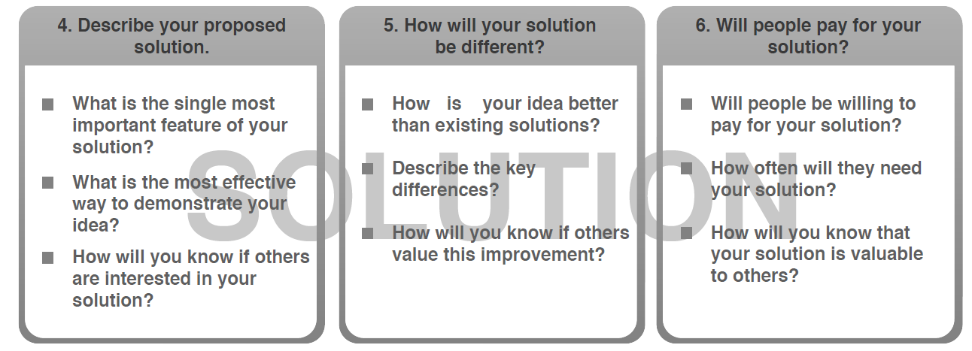
The Solution
© 2019, Rural Community Assistance Corporation. All rights reserved.
Notes:
Dan Box Four: What is the single most important feature of your solution? You might say something like, affordable, locally-grown, fresh fruits and vegetables. But that's really three features. It's important to understand what potential customers care about most. What most important? Is the most important feature that the produce is affordable, locally-grown, OR fresh. The Cooperative Farmers can guess which feature is most important to their customers, but what if they're wrong? What if they guess that the most important feature is that the fruits and vegetables will be fresh, but what if affordability is actually more important to their potential customers than the freshness or where the produce is grown.
The last question in box four asks, How will you know if others are interested in your solution? This is a really important question! There is a lot of money, time and effort involved in developing a new product, service, or project. For example, the Cooperative Farmers have to invest money and time in leasing the land, purchasing equipment, purchasing the seeds and supplies, growing the vegetables, and harvesting them. It would be a shame for them to invest all that time and effort only to learn that their potential customers don't want to pay more for locally-grown fresh produce than they do canned or frozen fruits and vegetables. Often the best answer to this question is, I plan to go out and talk to my potential customers.
Box Five: How is your idea better than existing solutions. This question is designed to help you think about how your product, service, or project is better than the ones offered by the competition? How will you ensure potential customers buy from you rather than the competition. Perhaps the Cooperative Farmers could offer exceptional customer service which could include printed cards with recipe ideas for the produce they are selling that week or perhaps they can offer free home delivery to Tribal elders.
Box Six: Will people be willing to pay for your solution? There's another important question that should be included with this question. Will people be willing to pay for your solution and if so, how much? Its not only important to know that potential customers will pay for a product or service, but how much they are willing to pay. For example, if the Farmers Cooperative needs to sell a pound of carrots for $2.29 in order for the farm to be sustainable but people are only willing to pay $1.89 a pound for fresh locally-grown carrots because they can buy frozen carrots at the store for $1.29 a pound that important information to know.
Completing the questions in the Solution section of the Ice House Discovery Canvas can help begin to think about how your produce, service, or project is better than the alternatives and how you will ensure potential customers buy from you; rather than the competition.

Slide 23
Problem & Solution Activity Report-Out
Notes:
V

Slide 24

Value Chains
Businesses, organizations and institutions linked together to help take a product or service to the consumer/market
Notes:
Liz
You can think of a value chain as a business model-
Businesses and services linked together
To take a product, service, or sector to the consumer and market
A value chain encompasses Everything it takes from start to finish- your connecting community assets with market demand, to build lasting livlihoods
Here are some sectors that could have a vc.

Slide 25
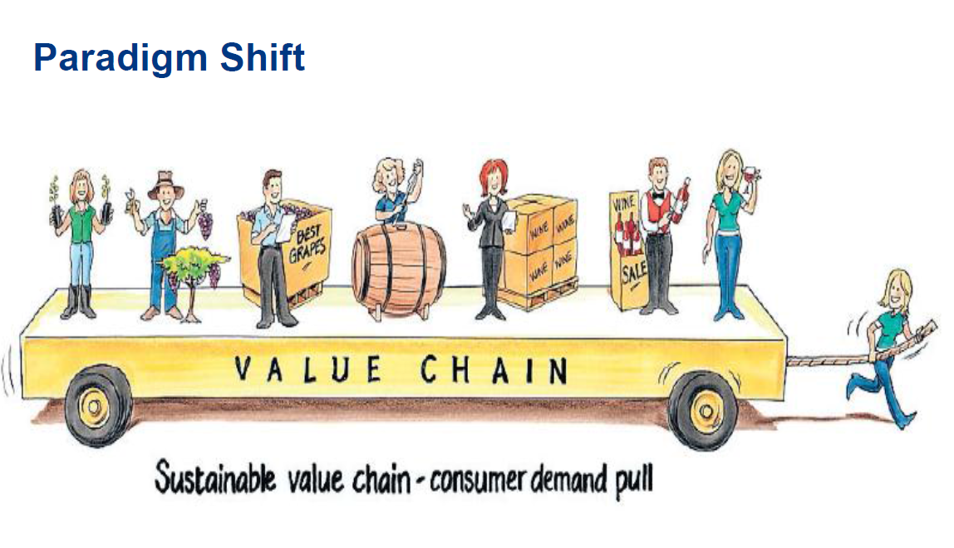
Andrew Fearne, University of Kent
Notes:
Dan:
What do you see in this one?
Rolling along with ease
Smiling faces
Assume folks are working together “ in it together”
Value Chains buy the products that are best for the community.
Focused on community benefits and care about local ownership and prosperity for all.

Slide 26
Value Chain Stakeholders
Demand
Transactional
Support
Notes:
Dan - Value Chain Partners: The group of “actors” linked together that get a sector of products or services to the market

Slide 27
Value Chain Stakeholders
Demand Partners:​
Buyers/consumers of goods and services ​
Transactional Partners:​
People, businesses, orgs with direct role in sourcing, producing, distributing​
Support Partners:​
People, businesses, orgs that provide infrastructure that helps the transactional partners obtain resources needed to produce the product/service
Notes:
Dan

Slide 28
Value Chain
Starts with DEMAND
​Measured by wealth created or maintained
Self-shared-common interests
Strong communication
High trust

Slide 29
Interest
Self-Interest
What's in it for me?
The strongest motivator
Shared Interest
What's in it for us?
When two or more partners recognize a win-win
Common Interest
What's in it for everyone?
Includes benefits outside the value chain
Notes:
Direct benefit: Self-interest and shared interest. Typically, what draws a partner into participation and investment in the value chain is something that will fulfill their self-interest. Self-interest can have many facets, not all of them financial. Here is a simple partial list of self-interest motivators:​
Saves cost ​
Stabilizes price ​
Ensures reliable supply ​
Creates local supply ​
Produces better quality ​
Increases self-sufficiency ​
Provides access to new markets ​
Diversifies product mix ​
Develops marketable skill or capacity ​
Fulfills mission ​
Improves image ​
Creates more jobs ​
Creates better jobs ​
Increases income ​
Reduces time wasted ​
Uses abandoned facility ​
Increases connections to power ​
​
The Broader benefit: Common interest. It is also important to look beyond direct benefits to broader benefits produced by a WealthWorks value chain. This can include benefits produced by the value chain that accrue to those people, places or businesses outside of the value chain. For example, Youth entrepreneurship program in the community can have broader benefits like becoming active leaders in the community, and showing up and contributing ideas at town meetings. The impacts are much more broad than just the program itself and can engage potential support partners. So, ask yourself "What broader benefits will this value chain produce for those outside the value chain?" And "Who is it that will benefit?" These can help expand your network of support.

Slide 30
Value Chain as an Asset Building Tool
A network of people, businesses, organizations, agencies addressing a market opportunity;​
To meet demand for specific products and services; advancing self-interest;​
While building rooted local and regional wealth.

Slide 31
Understanding Value Chain Partners
Helps you to:
Bring buyers/consumers, processors, producers and other transactional partners together for mutual benefit to create value in response to market demand.

Slide 32
Understanding Value Chain Partners
Helps you to:
Include direct engagement by support partners (educators, researchers, technical assistance providers, financers, policy-makers, etc.) who are critical to creating and maintaining wealth that sticks with their communities.

Slide 33
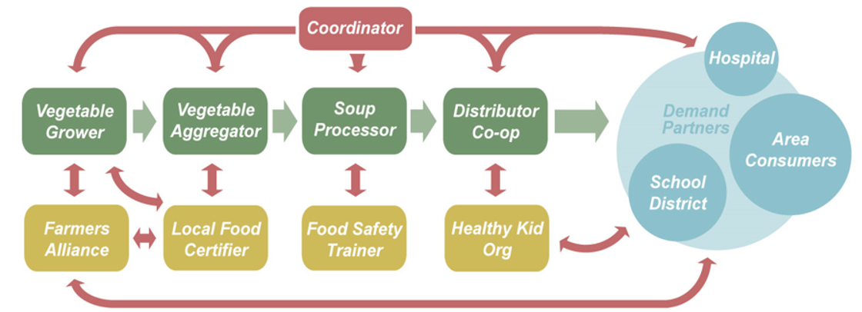
Value Chain Diagram
DEMAND PARTNERS
TRANSACTIONAL PARTNERS
SUPPORT PARTNERS
Notes:
Dan

Slide 34
Value Chain Mapping: Your Project
Notes:
Dan:
Now that we understand how Value Chains are constructed, we are going to ask you to create a Value Chain for your project.

Slide 35
Value Chain Mapping: Directions
Break into 3 groups:
Group gets sticky notes – blue, pink and green
Talk amongst yourselves to identify:
Demand Partners – pink
Transactional Partners - green
Support Partners - blue
Arrange sticky notes as a Value Chain to get your product or service to your demand partners
© 2019, Rural Community Assistance Corporation. All rights reserved.
Notes:
Count everyone off- 1 or 2
Each group gets the set of sticky notes COLORS
Arrange on flip charts or wall

Slide 36

Value Chain Mapping Reflection
What does ownership look like?
Did you notice any gaps in the value chain?
Is the demand clear?
Who else needs to participate for this to be successful?

Slide 37
Value Chain Mapping Report-Out
Notes:
Dan:
Now that we understand how Value Chains are constructed, we are going to ask you to create a Value Chain for your project.

Slide 38
Lunch Break

Slide 39
Action Planning for your Value Chain
Notes:
Dan:
Now that we understand how Value Chains are constructed, we are going to ask you to create a Value Chain for your project.

Slide 40
What Did We Learn Today?
Goal #1:
First Objective:
Steps/Milestones to achieve this objective | Responsible Party | Proposed Completion Date | Resources and/or Partners
Second Objective:
Steps/Milestones to achieve this objective | Responsible Party | Proposed Completion Date | Resources and/or Partners
Third Objective:

Slide 41
What Did We Learn Today?
Identification of trends, lessons learned, opportunities
Who else needs to be part of this discussion?

Slide 42
Schedule, Homework, and Next Steps
Next In-Person Session (8am - 2pm):
Workshop #4: Wednesday, November 19, 2025
Refining action plans for selected projects
Homework:
Refine your projects and share them with neighbors, friends, and fellow residents
Recruit more value chain partners to the final workshop
Notes:
Dan
8am – 2pm, same location
Remind folks that they can join when they can

Slide 43
Parking Lot

Slide 44
Closing: Pluses & Deltas
Things you liked?
Things that worked well?
Things we can improve on?
Opportunities for change?
Notes:
Record on a flip chart the class participants opinions on what they liked and disliked in today’s training. Use probing questions if needed to identify things that worked well or did not work well

Slide 45
ROCE Team Contacts:
Verna "V" Al-ag
Community Economic Development Consultant
RCAC | (831) 887-8362
Vernalou.al-ag@rcac.org
Dan Dever
Community Economic Development Consultant
RCAC | (602) 818-9409
dan.dever@rcac.org
Carissa Patrone Maikuri
Economic Recovery Corps Fellow
ERC & RCAC | (734) 365-3801
Carissa.PatorneMaikuri@rcac.org
Zachary Gately
Grant Manager
Plumas County
(530) 283-6414
ZacharyGately@countyofplumas.com
Tracey Ferguson
Planning Director
Plumas County
(530) 283-6214
TraceyFerguson@countyofplumas.com
Notes:
Record on a flip chart the class participants opinions on what they liked and disliked in today’s training. Use probing questions if needed to identify things that worked well or did not work well

Slide 46
Thank You!

